Slide 1
Score-Based Diffusion Models
lecture 16
CS236: Deep Generative Models

Slide 2
Plan for today
Recap on score-based models
Diffusion models as score-based models
Diffusion models as (hierarchical) VAEs
Diffusion models as normalizing flow models
Efficient sampling strategies
Controllable generation

Slide 3
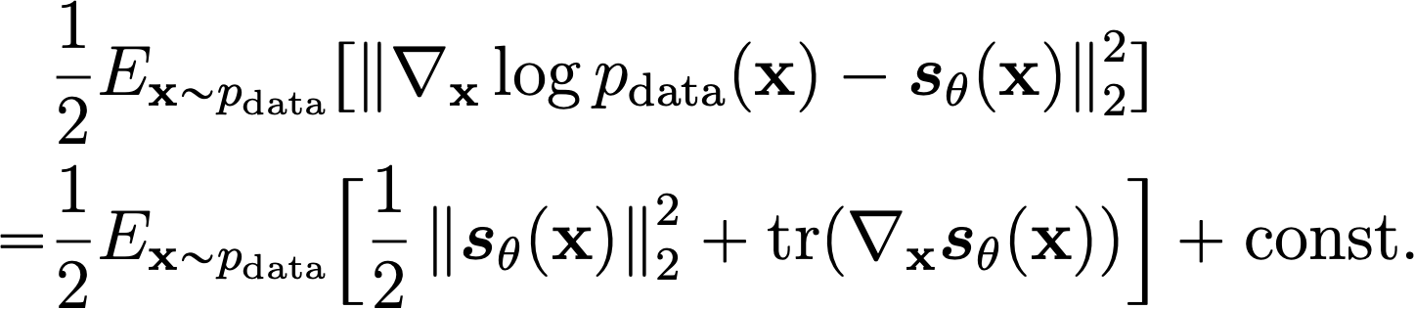
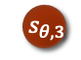
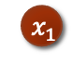
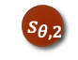
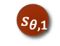
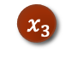
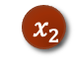
Score-based models
A model that represents the score function
Score estimation: training the score-based model from datapoints
Score matching
Not scalable for deep score-based models and high dimensional data
$${ x}_{1}$$
$${ s}_{θ,1}$$
$${ x}_{2}$$
$${ s}_{θ,2}$$
$$x_{3}$$
$${ s}_{θ,3}$$

Slide 4
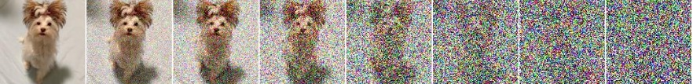
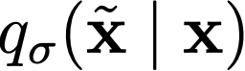
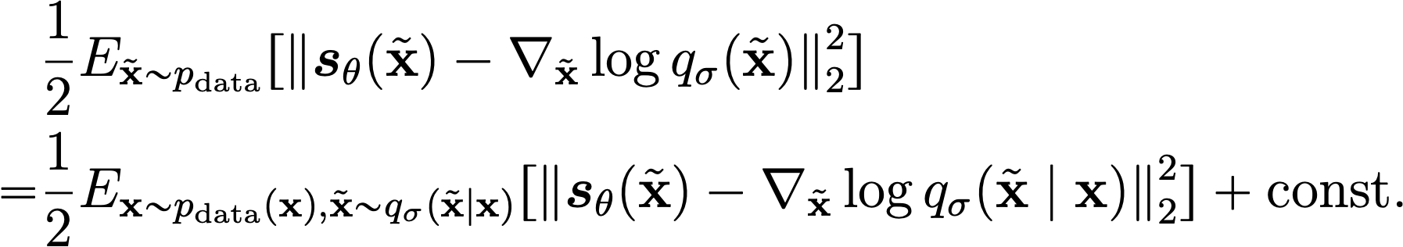
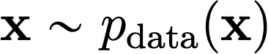
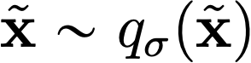
Denoising score matching
Pros:
Much more scalable than score matching
Reduces score estimation to a denoising task
Con: estimates score of noise-perturbed data
Perturbation
distribution/kernel
Data
distribution
Noise-perturbed
data distribution

Slide 5

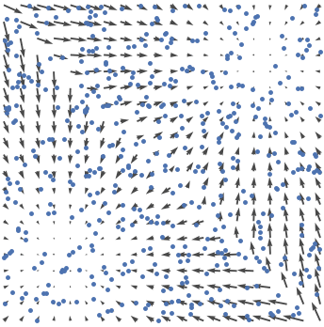

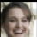
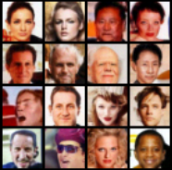




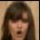
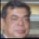

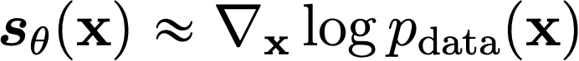
Score-based generative modeling
score
matching
Langevin
dynamics
Data samples
Scores
New samples
Notes:
So far, I have discussed how to estimate scores efficiently from iid samples of a distribution. We can have a score model, and then train it with some efficient variant of score matching to approximate the score of p.
Next, I will show how to build a generative model using the estimated score. This requires us to sample from the score model efficiently.

Slide 6
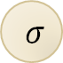
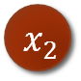
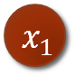
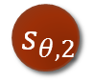
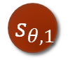
Joint Score Estimation via Noise Conditional Score Networks
$${ x}_{1}$$
$${ s}_{θ,1}$$
$${ x}_{2}$$
$$σ$$
$${ s}_{θ,2}$$
Noise Conditional Score Network
(NCSN)
Notes:
More specifically, for each perturbed data distribution, we can easily sample from them, and use score estimation to estimate the corresponding scores.
However, the most naïve way of doing this requires a large number of separate score models to be learned independently, which is very costly.
We propose instead to use a single conditional score network to estimate the scores jointly for all perturbation levels. The score model will take sigma as an input. This model is named the Noise Conditional Score Network.

Slide 7
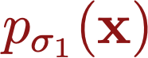

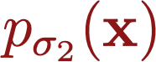

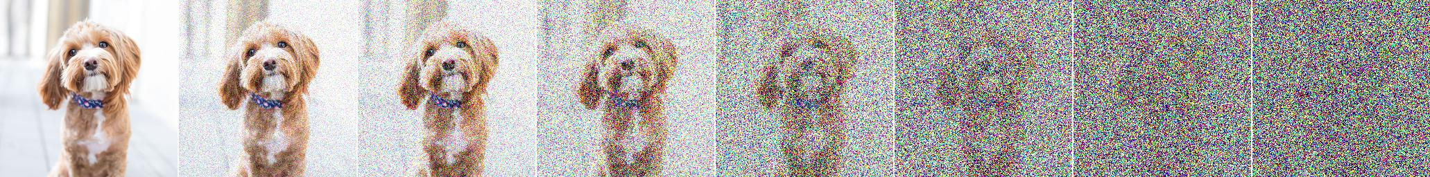
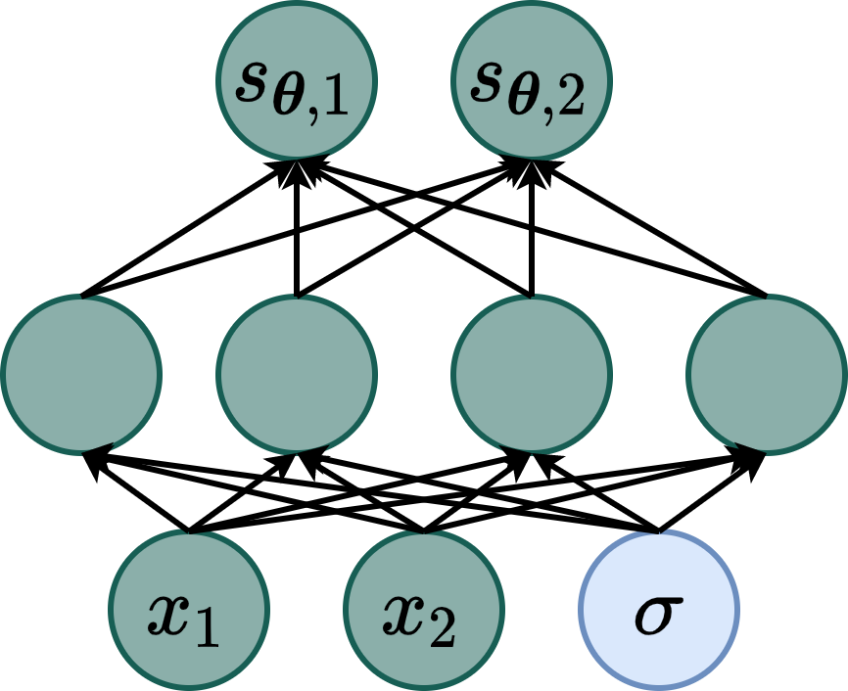
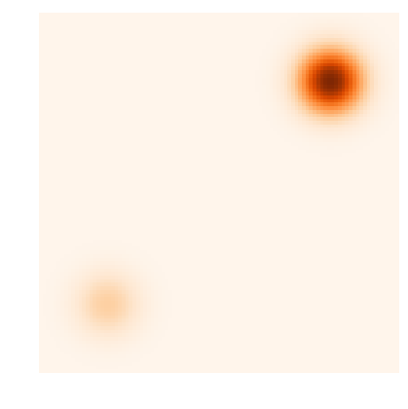
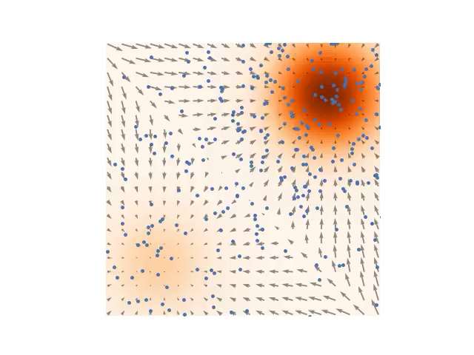
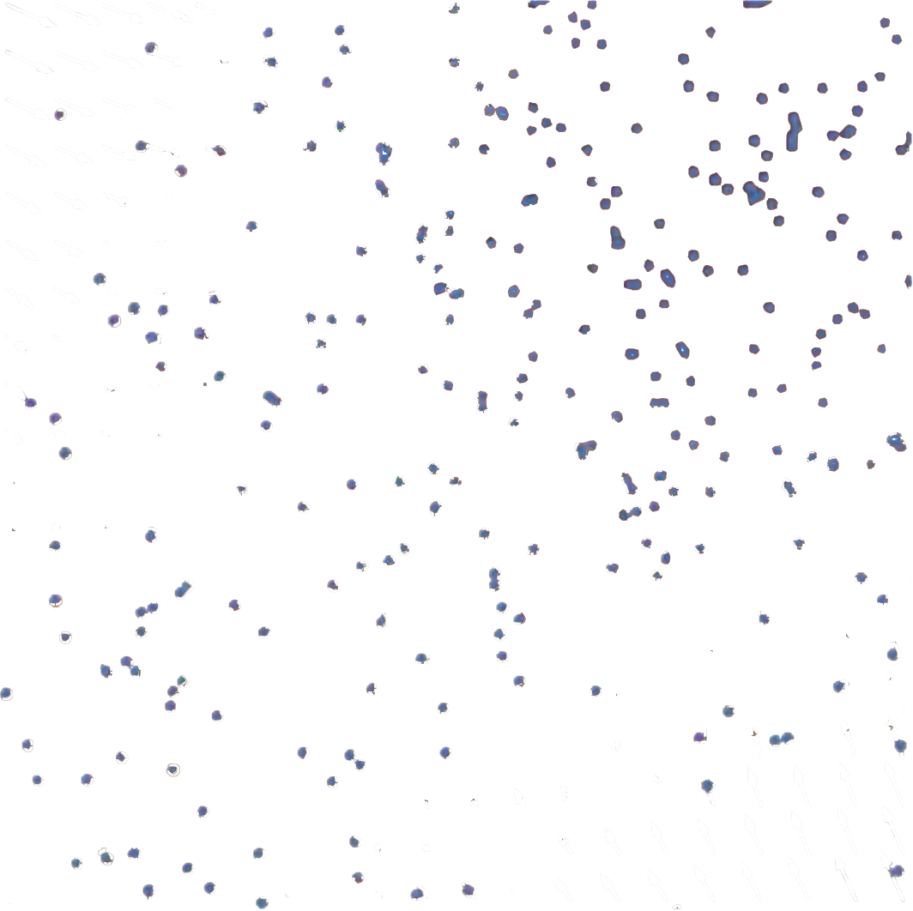
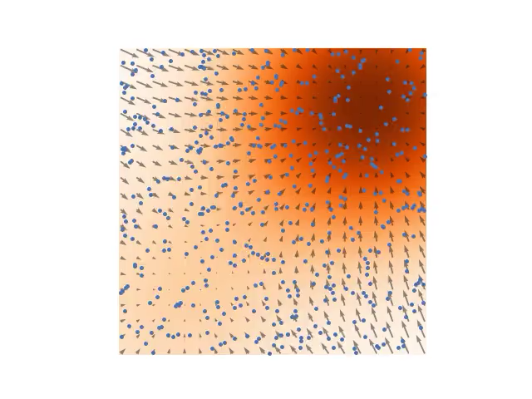
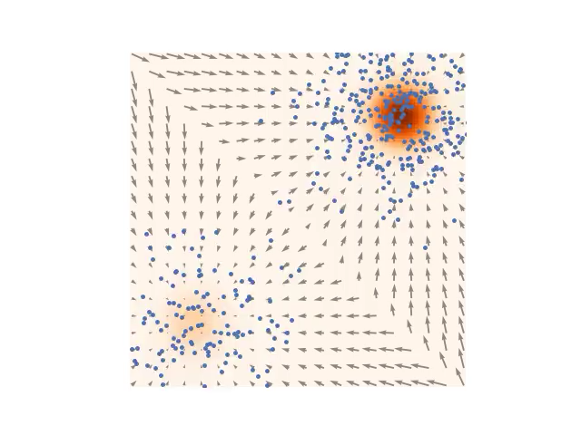
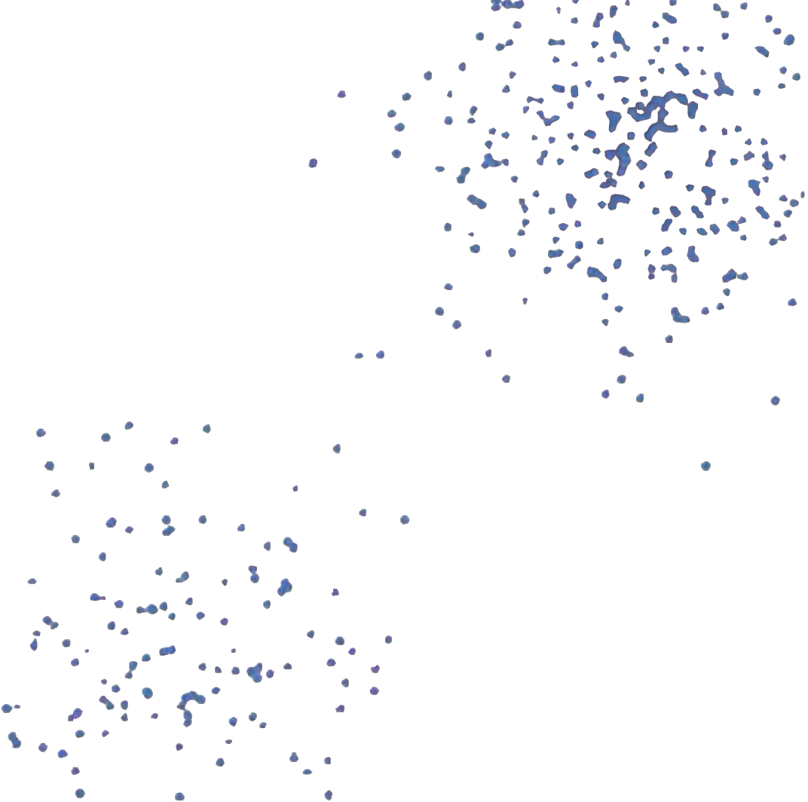
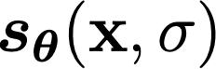
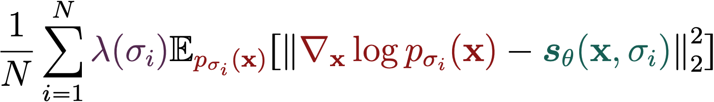
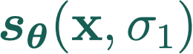
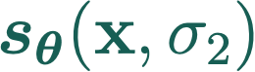

Using multiple noise levels
Data
Positive weighting
function
Annealed Langevin dynamics
Noise Conditional
Score Model
Score matching loss

Slide 8
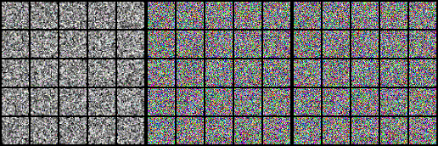
Experiments: Sampling
Notes:
The following demonstrates the sampling procedure of annealed Langevin dynamics using estimated scores on several image datasets. It is pretty amazing that we can start from random noise, modify the images according to scores, and generate nice looking images.

Slide 9
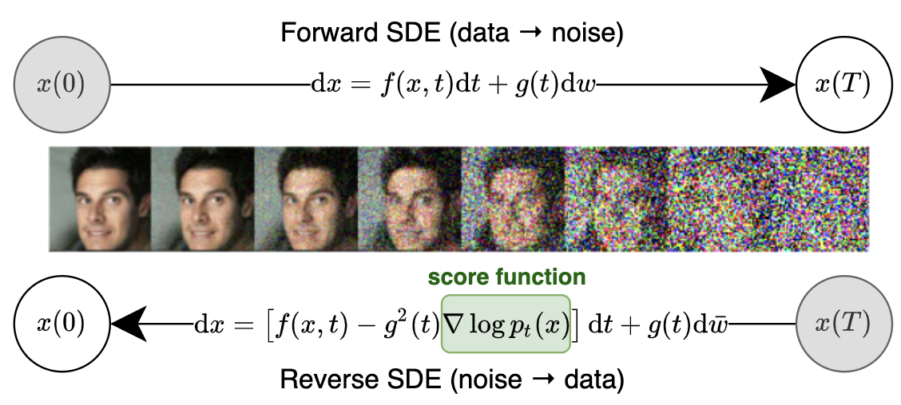
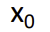
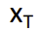
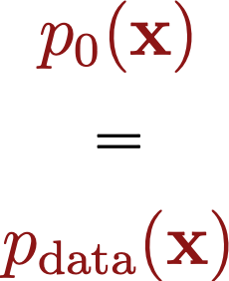
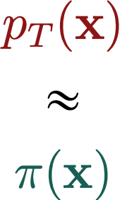
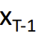
Sampling as Iterative Denoising
Inverse process: iteratively add Gaussian noise
q
q
T
T
Langevin
Langevin
Langevin
Start from pure noise
…
…
Iteratively remove noise
Notes:
The method can be further generalized to an infinite number of noise scales. Here the noise perturbation becomes a diffusion process that perturbs data with continuously increasing intensity through time.
This diffusion process can be described as a solution to an SDE, namely a stochastic differential equation. By reversing this diffusion process, we can generate samples from random noise.
Crucially, the reverse diffusion process can be obtained by solving a reverse-time SDE, and we can derive this reverse-time SDE once we have the score of the distribution at each intermediate time step is known. Similarly to the case with finite noise scales, we can learn this time-dependent score by training a time-depedent score network with a continuous mixture of score matching objectives.

Slide 10
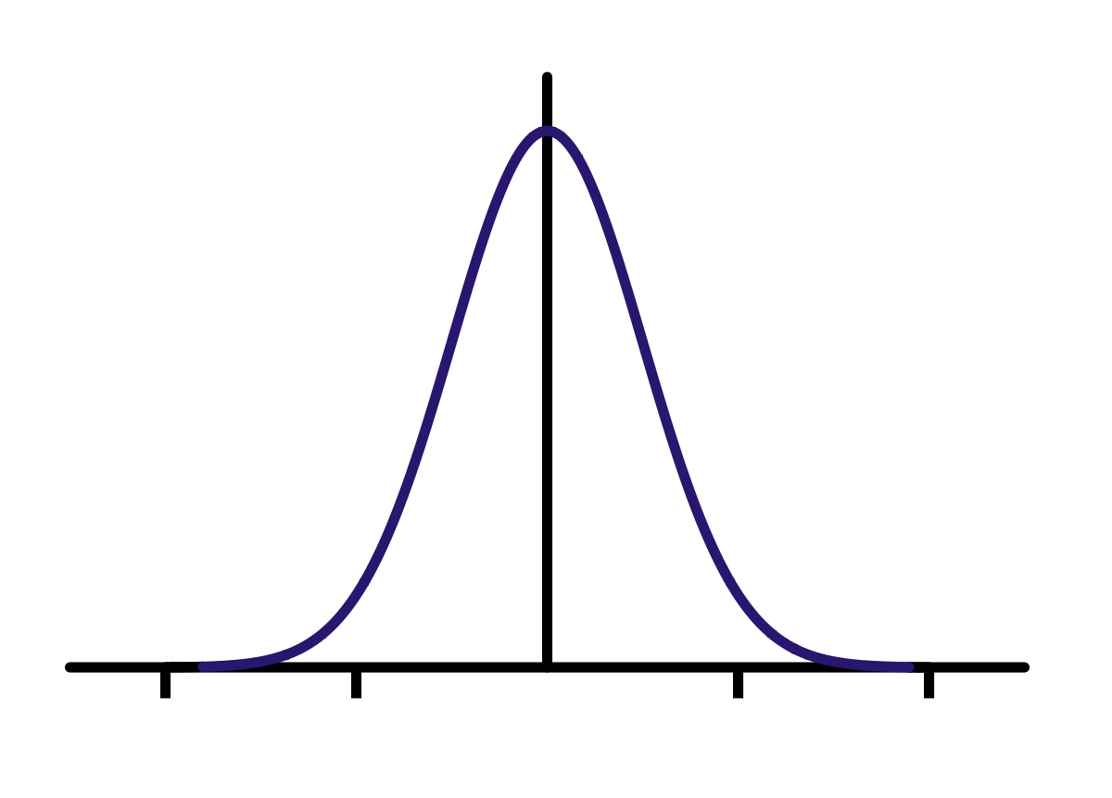
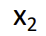
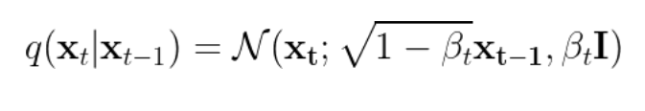
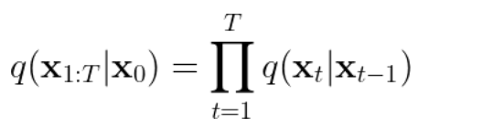
Iterative noising process
Progressively add noise
q
q
T
T
Noise perturbed densities are obtained by adding Gaussian noise
Defines a joint distribution
Notes:
The method can be further generalized to an infinite number of noise scales. Here the noise perturbation becomes a diffusion process that perturbs data with continuously increasing intensity through time.
This diffusion process can be described as a solution to an SDE, namely a stochastic differential equation. By reversing this diffusion process, we can generate samples from random noise.
Crucially, the reverse diffusion process can be obtained by solving a reverse-time SDE, and we can derive this reverse-time SDE once we have the score of the distribution at each intermediate time step is known. Similarly to the case with finite noise scales, we can learn this time-dependent score by training a time-depedent score network with a continuous mixture of score matching objectives.

Slide 11
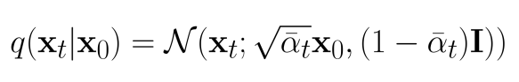
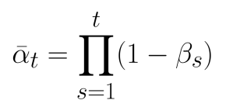
Multistep transition
q
Multi-step transitions are also Gaussian and can be computed in closed form
Same as noise-perturbed data distributions in score-based models
Efficient sampling at any t
Notes:
The method can be further generalized to an infinite number of noise scales. Here the noise perturbation becomes a diffusion process that perturbs data with continuously increasing intensity through time.
This diffusion process can be described as a solution to an SDE, namely a stochastic differential equation. By reversing this diffusion process, we can generate samples from random noise.
Crucially, the reverse diffusion process can be obtained by solving a reverse-time SDE, and we can derive this reverse-time SDE once we have the score of the distribution at each intermediate time step is known. Similarly to the case with finite noise scales, we can learn this time-dependent score by training a time-depedent score network with a continuous mixture of score matching objectives.

Slide 12



Diffusion perspective
q
q

Slide 13


Iterative Denoising
q
q
T
T
Ideal sampling process:
Sample from , i.e. from pure noise
Iteratively sample from the true denoising distribution
Issue: Exact denoising distribution is unknown!
Solution: Learn a variational approximation
Notes:
The method can be further generalized to an infinite number of noise scales. Here the noise perturbation becomes a diffusion process that perturbs data with continuously increasing intensity through time.
This diffusion process can be described as a solution to an SDE, namely a stochastic differential equation. By reversing this diffusion process, we can generate samples from random noise.
Crucially, the reverse diffusion process can be obtained by solving a reverse-time SDE, and we can derive this reverse-time SDE once we have the score of the distribution at each intermediate time step is known. Similarly to the case with finite noise scales, we can learn this time-dependent score by training a time-depedent score network with a continuous mixture of score matching objectives.

Slide 14



Iterative Denoising
q
q
T
T
Sample from
Iteratively sample from
Joint distribution:
Notes:
The method can be further generalized to an infinite number of noise scales. Here the noise perturbation becomes a diffusion process that perturbs data with continuously increasing intensity through time.
This diffusion process can be described as a solution to an SDE, namely a stochastic differential equation. By reversing this diffusion process, we can generate samples from random noise.
Crucially, the reverse diffusion process can be obtained by solving a reverse-time SDE, and we can derive this reverse-time SDE once we have the score of the distribution at each intermediate time step is known. Similarly to the case with finite noise scales, we can learn this time-dependent score by training a time-depedent score network with a continuous mixture of score matching objectives.

Slide 15

Diffusion model as a hierarchical VAE
Encoder (fixed):
q
T
T
q
Prior over latents
Decoder (learnable):
Notes:
The method can be further generalized to an infinite number of noise scales. Here the noise perturbation becomes a diffusion process that perturbs data with continuously increasing intensity through time.
This diffusion process can be described as a solution to an SDE, namely a stochastic differential equation. By reversing this diffusion process, we can generate samples from random noise.
Crucially, the reverse diffusion process can be obtained by solving a reverse-time SDE, and we can derive this reverse-time SDE once we have the score of the distribution at each intermediate time step is known. Similarly to the case with finite noise scales, we can learn this time-dependent score by training a time-depedent score network with a continuous mixture of score matching objectives.

Slide 16


From VAE to Hierarchical VAE
Basic VAE:
ELBO training:

Slide 17

From VAE to Hierarchical VAE
Hierachical VAE (decoder): p(x, z₁ , z₂) = p(z₂) p(z₁ | z₂) p(x | z₁)
Sample z₂ from a simple prior $N\left(0,I\right)$
Sample z₁ from a decoder p(z₁ | z₂)
Sample x from a decoder p(x | z₁)
Encoder: q(z_{1,} z₂ | x)
ELBO training: $E_{\text{q}\text{(}\text{z}\text{1, }\text{z}\text{2}\text{ | }\text{x}\text{)}}\left[\log\left(\frac{\text{p}\text{(}\text{x}\text{, }\text{z}\text{1 }\text{, }\text{z}\text{2}\text{)}}{\text{q}\text{(}\text{z}\text{1, }\text{z}\text{2}\text{ | }\text{x}\text{) }}\right)\right]$
z₂
z₁

Slide 18

Training a denoising diffusion probabilistic model
Encoder (q) has no learnable parameters!
Encoder (fixed):
q
Decoder:
ELBO loss (negative ELBO averaged over data distribution):
Notes:
The method can be further generalized to an infinite number of noise scales. Here the noise perturbation becomes a diffusion process that perturbs data with continuously increasing intensity through time.
This diffusion process can be described as a solution to an SDE, namely a stochastic differential equation. By reversing this diffusion process, we can generate samples from random noise.
Crucially, the reverse diffusion process can be obtained by solving a reverse-time SDE, and we can derive this reverse-time SDE once we have the score of the distribution at each intermediate time step is known. Similarly to the case with finite noise scales, we can learn this time-dependent score by training a time-depedent score network with a continuous mixture of score matching objectives.

Slide 19


Diffusion models as score-based models
The ELBO objective is
Decoder parameterization:
Up to scaling, predict noise that was added and subtract it
ELBO loss reduces to denoising score matching!

Slide 20

Training and inference
Denoising score matching training
Iteratively Sample from decoders
(Annealead Langevin Dynamics)

Slide 21

Architecture for the denoiser
Unet architecture used in practice
Same as the noise-condtional score network (t represents the time index or equivalently the noise level)

Slide 22



Infinite noise levels

Slide 23








Perturbing data with stochastic processes
Stochastic process
Stochastic differential equation (SDE)
Deterministic drift
Infinitesimal noise
Probability densities
WLOG: Toy SDE

Slide 24



Generation via reverse stochastic processes
Forward SDE (t: 0→T)
Infinitesimal noise in the reverse time direction
Reverse SDE (t: T→0)
Score function!

Slide 25


Score-based generative modeling via SDEs
Time-dependent score-based model
Training:
Reverse-time SDE
Euler-Maruyama (analgous to Euler for ODEs)
Song, Sohl-Dickstein, Kingma, Kumar, Ermon, Poole. “Score-Based Generative Modeling through Stochastic Differential Equations.” ICLR 2021.
Notes:
Therefore, we can generate samples by solving the reverse-time SDE to simulate the reverse-time stochastic process.
One numerical solver for SDEs is the Euler-Maruyama method. It is based on the same idea as Euler’s method for solving ODEs. Basically, we replace the infinitesimal time step dt with a small time difference Delta t, and we replace the infinitesimal white noise with a Gaussian noise with variance Delta t. Here Delta t is a negative time step, and t goes from T to 0.
We can train a time-dependent score-based model to approximate the score function as a function of time. This time-dependent score-based model is a neural network conditioned on time t, and can be trained by first randomly sampling t, and then minimizing the corresponding score matching loss.

Slide 26
Predictor-Corrector sampling methods
Predictor-Corrector sampling.
Predictor: Numerical SDE solver
Corrector: Score-based MCMC
corrector
predictor
Notes:
We can apply any other general-purpose SDE solver for sampling. Besides, knowing the score function allows new SDE solvers and hence new samplers. The first method we consider is one family of methods named predictor-corrector samplers. As the name suggests, the method consists of a predictor and a corrector. The predictor can be a general-purpose SDE solver like the Euler-Maruyama method, and the corrector can be any score-based MCMC approach such as Langevin dynamics.
So how does the method work? When solving the reverse-time SDE, we first use the predictor to get a rough estimate of the intermediate sample at the next time step, and then use the corrector to fine-tune the sample. This procedure is repeated multiple times until we finally get a sample from the original unperturbed data distribution.
Predictor-Corrector methods assembles annealed Langevin dynamics. However, the introduction of the predictor helps Langevin dynamics to make a smooth transition between different noise scales.

Slide 27

Results on predictor-corrector sampling
Song, Sohl-Dickstein, Kingma, Kumar, Ermon, Poole. “Score-Based Generative Modeling through Stochastic Differential Equations.” ICLR 2021.
Notes:
With predictor-corrector samplers and some architectural improvements, we were able to set the new record of sample generation on CIFAR-10. Our results are highlighted with the green box. There are several configurations of our NCSN++ model which I won’t be able to cover in this talk. Our best model achieves an FID of 2.2, and inception score of 9.89. The previous best result was achieved by StyleGAN2 plus data augmentation, yet we were able to surpass their result even without data augmentation. Moreover, our FID score on unconditional generation is even better than the state-of-the-art on conditional generation. This is a really exciting breakthrough.

Slide 28


High-Fidelity Generation for 1024x1024 Images
Notes:
With predictor-corrector samplers and new progressive growing architectures, we were able to produce the first set of high resolution facial samples from score-based models. All the samples here have a resolution of 1024x1024.

Slide 29





Converting the SDE to an ODE
SDE
Ordinary differential equation (ODE)
Score function

Slide 30
Converting the SDE to an ODE
We can think of this as a (continuous time, infinite depth) normalizing flow
Unique ODE solution → Invertible mapping
To invert, solve ODE backwards from T to 0

Slide 31






Evaluating likelihoods with ODEs (flow model)
→ ODE
Computing the probability density function (change of variables formula)
Computable in polynomial time
Unbiased
estimator
ODE solver

Slide 32

Competitive likelihoods on test data
Negative log-probability ↓
(bits/dim)
Method | CIFAR-10 | ImageNet 32x32
PixelSNAIL [Chen et al. 2018] | 2.85 | 3.80
Delta-VAE [Razavi et al. 2019] | 2.83 | 3.77
Sparse Transformer [Child et al. 2019] | 2.80 | –
Score flow model | 2.83 | 3.76
Challenges years of dominance of autoregressive models and VAEs

Slide 33
Accelerated sampling
→ ODE
Numerical methods + ODE formulation to accelerate sampling
DDIM [Song and Ermon, 2021]:
Coarsely discretize the time axis, take big steps
Corresponds to exponential integrator (semi-linear ODE) [Lu et al, 2022; Zhang and Chen, 2022]
10x-50x speedups, comparable sample quality

Slide 34


Parallel ODE solving

Slide 35
Distillation
student
student
student
→ ODE
Progressive distillation [Salimans, Ho 2022]
DDIM sampler as a teacher model
Student model trained to do in 1 step what DDIM achieves in 2 steps
Applied recursively to drastically reduce the number of steps required

Slide 36

On distillation of guided diffusion models
Meng, Rombach, Gao, Kingma, Ermon, Ho, Salimans “On distillation of guided diffusion models.” 2023.

Slide 37

Latent diffusion model
VAE mapping data to lower dimensional space
Faster
Can be applied to any data type (e.g. discrete)
Diffusion model prior over the latent space of the autoencoder

Slide 38
Stable diffusion text2image model
VAE mapping data to lower dimensional space
Pre-trained, focus on reconstruction (autoencoder)
Diffusion model prior over the latent space of the autoencoder
2. Trained in the second stage, keeping initial autoencoder fixed
Large scale, open source model, widely adopted

Slide 39

Conditional generation
User input:
An astronaut riding a horse
39

Slide 40


Conditional generation
Let (x,y) denote (image,caption) pairs
Training a conditional generative model involves learning p(x | y)
Train score model for the image x conditional on caption y
Need a suitable architecture
40

Slide 41














Control the generation process
Bayes’ rule:
Bayes’ rule for score functions:
Forward model
Control signal
= “dog”
0
Plug in different forward models for the same score model
Unconditional score
Forward model
Inverse distribution

Slide 42


Stroke to image synthesis
Forward model
can be specified.
Stroke paintings
Sampled images
[Meng, He, Song, Song, Wu, Zhu, Ermon. ICLR 2022]

Slide 43





Language-guided image generation
(Prompt)
Treehouse in the style of Studio Ghibli animation
Forward model
is an image captioning neural network.
[ Work by @danielrussruss ]

Slide 44


Controllable generation: Text-guided generation
An abstract painting of computer science:
A painting of the starry night by van Gogh
https://colab.research.google.com/drive/1FuOobQOmDJuG7rGsMWfQa883A9r4HxEO?usp=sharing

Slide 45
Classifier-free guidance
Bayes’ rule:
Bayes’ rule for score functions:
Conditional score
0
Unconditional score
Classifier obtained as the difference

Slide 46
Classifier-free guidance
Train both a conditional and an unconditional score model (by randomly dropping the caption during training)
Combine the two models as follows
w is the classifier-guidance strength

Slide 47

Effect of classifier guidance
Increased classifier guidance strength (w)

Slide 48
Summary
Discrete time diffusion model as a hierarchical VAE
Connections with score-based models (ELBO equivalence to score matching)
Continuous time diffusion models
SDE perspective: VAE with an infinite number of latent variables
ODE perspective: normalizing flow (exact likelihoods!)
Accelerated sampling
Advanced numerical methods for solving ODE/SDEs
Distillation
Controllable generation
Classifier guidance
Classifier-free guidance

